Slide 1
Instagram Performance Analysis For
Sugar Cosmetics
50,000 posts | Apr 2024 to Apr 2025 | Power BI dashboard
--- Saish Bhalchandra Bore
Digital Marketing and Business Intelligence project

Slide 2
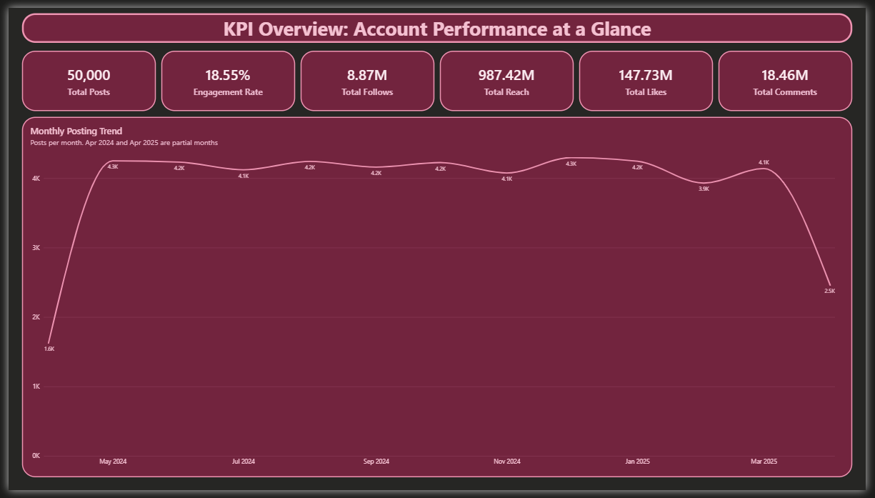
POWER BI PAGE 1 | KPI OVERVIEW | TASKS 1 AND 2
Steady posting: about 4,000 posts a month at 18.55% engagement
WHAT WE SEE
50,000 posts, 987M reach, 147.7M likes and 8.87M follows
Engagement rate is 18.55%: (likes + comments + shares + saves) / reach
Apr 2024 and Apr 2025 are partial months, so their dips are not real declines
Business implication: Posting volume is already consistent, so growth must come from content quality and conversion, not from posting more.

Slide 3
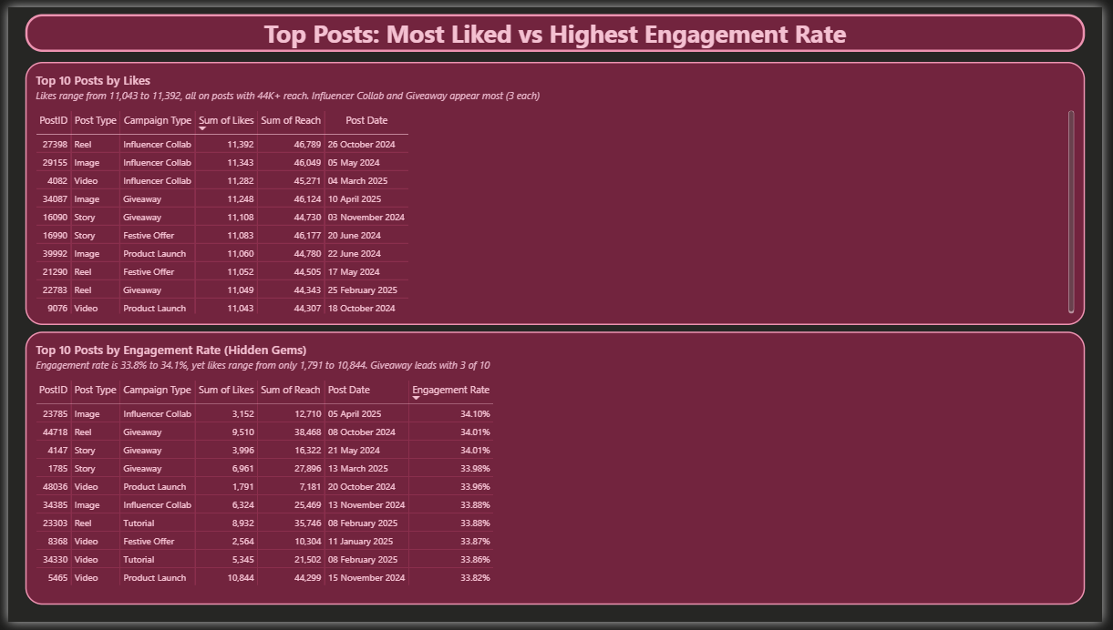
POWER BI PAGE 2 | TOP POSTS | TASKS 3 AND 4
The most liked posts are not the highest engagement posts
WHAT WE SEE
Top 10 by likes: 11,043 to 11,392 likes, all on posts with 44K+ reach
Top 10 by engagement rate: 33.8% to 34.1%, with likes from only 1,791 to 10,844
Influencer Collab and Giveaway appear 3 times each in the likes list; Giveaway leads the engagement list with 3 of 10
Business implication: Judge content by engagement rate as well as likes. High-engagement, lower-reach posts are hidden gems worth repeating or boosting with paid reach.

Slide 4
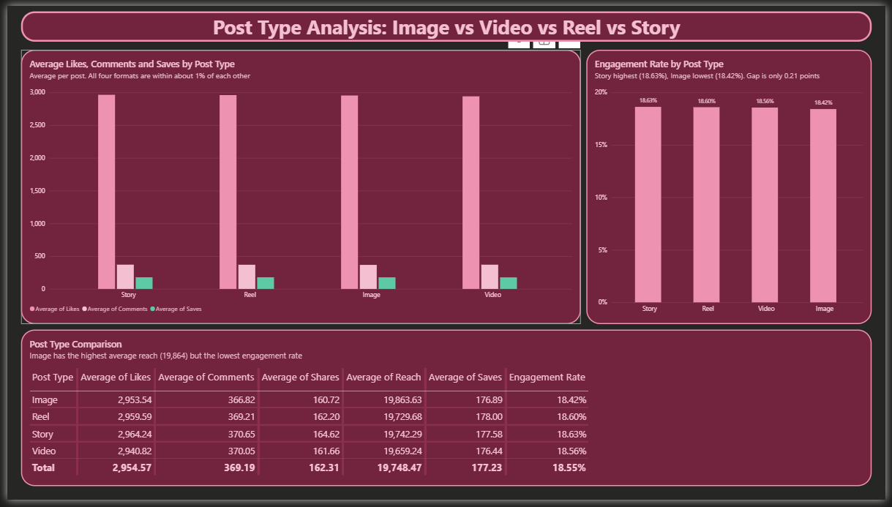
POWER BI PAGE 3 | POST TYPE ANALYSIS | TASK 5
All four post types perform within about 1% of each other
WHAT WE SEE
Engagement rate: Story 18.63%, Reel 18.60%, Video 18.56%, Image 18.42%
Average likes range only from 2,941 to 2,964 per post
Image has the highest average reach (19,864) but the lowest engagement rate
Business implication: Format is not the main lever. Choose formats for creative fit, not for expected engagement.

Slide 5
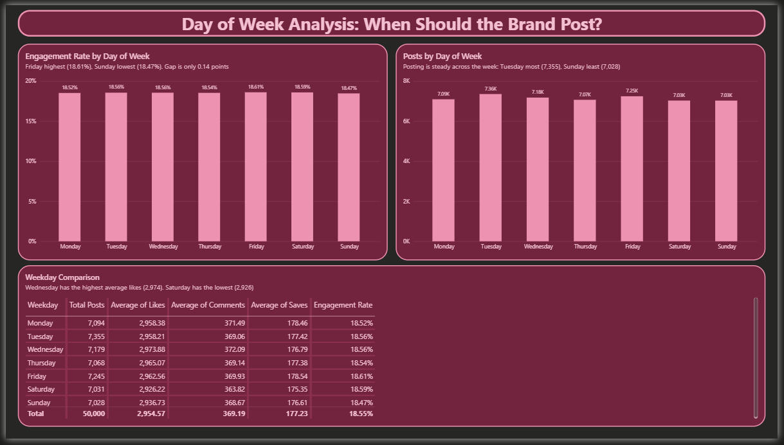
POWER BI PAGE 4 | DAY OF WEEK ANALYSIS | TASK 6
Weekday barely matters: Friday leads by only 0.14 points
WHAT WE SEE
Friday is highest (18.61%), Saturday 18.59%, Sunday lowest (18.47%)
Wednesday has the highest average likes (2,974); Saturday the lowest (2,926)
Posting is balanced: 7,028 to 7,355 posts on every weekday
Business implication: Use Friday and Saturday for key launches, but there is no need to avoid other days.

Slide 6
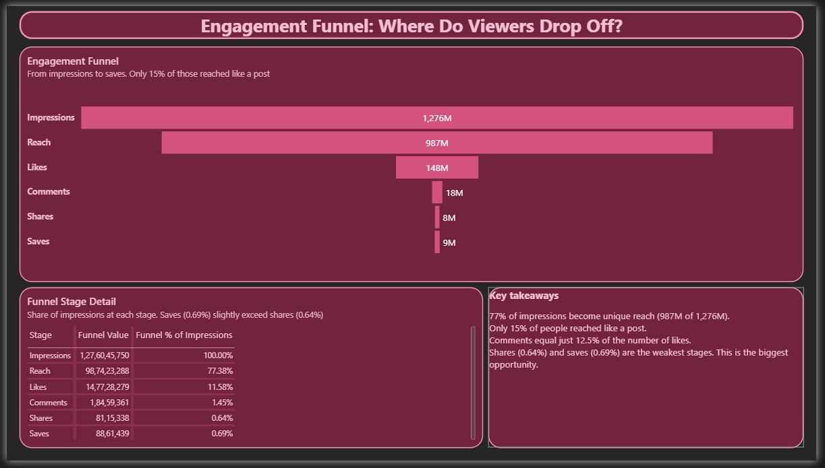
POWER BI PAGE 5 | ENGAGEMENT FUNNEL | TASK 7
The funnel leaks after reach: only 15% of those reached like a post
WHAT WE SEE
77% of impressions become unique reach (987M of 1,276M)
Likes are 11.6% of impressions; comments only 1.45%
Shares (0.64%) and saves (0.69%) are the weakest stages
Business implication: The biggest opportunity is save-worthy and shareable content, such as tutorials, shade guides and checklists, with clear calls to action.

Slide 7
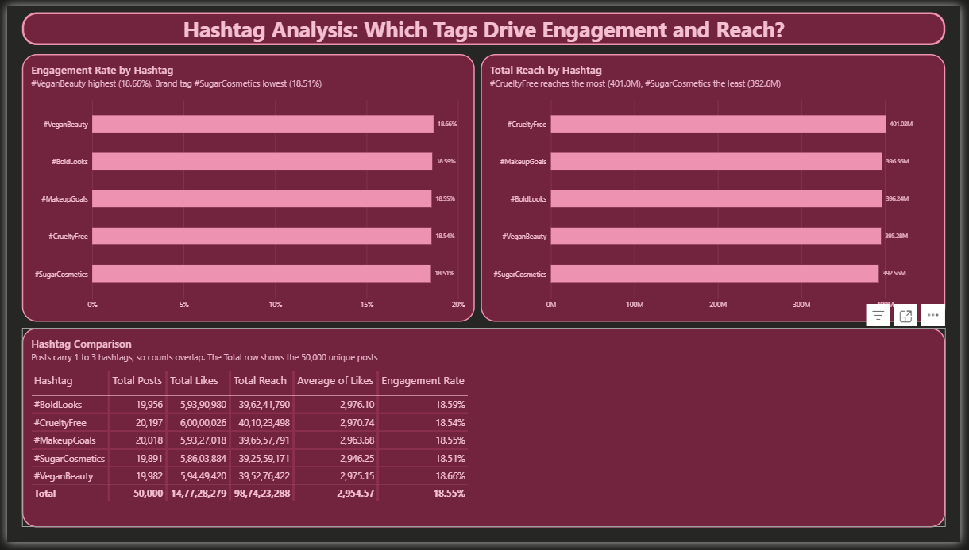
POWER BI PAGE 6 | HASHTAG ANALYSIS | TASK 8
Values-based hashtags edge out the brand hashtag
WHAT WE SEE
#VeganBeauty has the highest engagement (18.66%); #SugarCosmetics the lowest (18.51%)
#CrueltyFree has the biggest total reach (401M)
Posts with 2 to 3 hashtags average 2,972 to 2,981 likes vs 2,910 with one
Business implication: Lead with values-based tags (#VeganBeauty, #CrueltyFree) and use 2 to 3 per post.

Slide 8
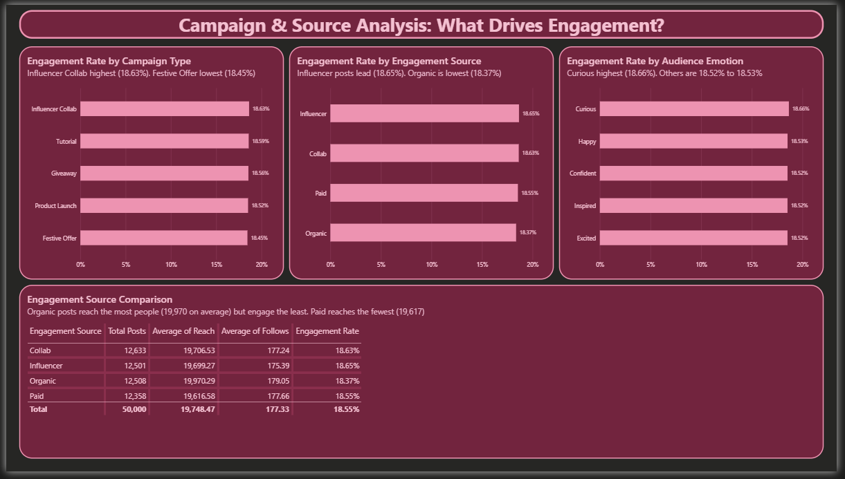
POWER BI PAGE 7 | CAMPAIGN AND SOURCE ANALYSIS | SUPPORTS TASK 10
Influencer-led content beats organic on engagement
WHAT WE SEE
Influencer 18.65% and Collab 18.63% vs Organic 18.37%
Organic has the highest reach per post (19,970) but the lowest engagement
Influencer Collab is the top campaign (18.63%); Festive Offer the weakest (18.45%)
Business implication: Move part of the organic effort into influencer collaborations, and rework the Festive Offer creative.

Slide 9
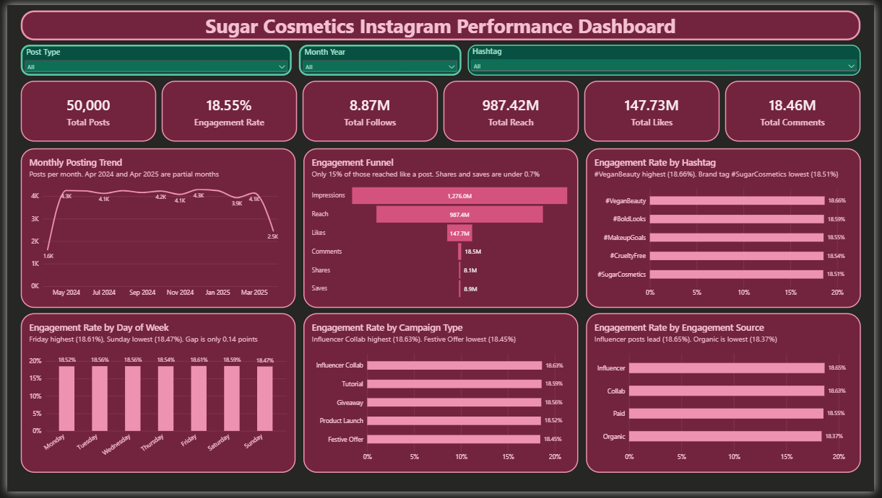
POWER BI PAGE 8 | FINAL DASHBOARD | TASK 9
One interactive dashboard answers every performance question
WHAT WE SEE
Slicers for Post Type, Month Year and Hashtag
Clicking any bar cross-filters every card and chart
Six KPI cards and six charts on a single page
Business implication: The team can drill into any slice of the data, such as one format, month or hashtag, without requesting a new report.

Slide 10
TASK 10 | STRATEGIC RECOMMENDATIONS
Recommendations and campaign tests
RECOMMENDATIONS
CAMPAIGN IDEAS TO TEST
When to post: Friday and Saturday for key launches (18.61%, 18.59%), but keep posting daily. The gap is only 0.14 points.
What to post: more influencer collaborations, Story and Reel formats, and curious, question-led hooks (Curious 18.66%).
Grow engagement and followers: add save and share calls to action, ask questions, use 2 to 3 hashtags (2,972 to 2,981 average likes vs 2,910 for one), and lift the 30% profile-visit-to-follow rate.
Gaps: no caption or creative data, organic underperforms, and shares and saves are low.
Influencer tutorial series, measured on saves and shares
Friday vs Wednesday launch of similar products
Values-based hashtags vs the brand tag
Festive Offer refresh with a giveaway angle
A month of posts with a "save for later" call to action
Caveat: most gaps between categories are under 1 point, so treat these as tests, not big strategy shifts. Apr 2024 and Apr 2025 are partial months, and hashtag counts overlap because a post can carry up to 3 tags.

